Slide 1
Memory Forensics Investigation: Credential Theft & Attack Reconstruction
Team:
Devarshi Mahadevwala | Jay Patel | Jay Joshi | Kedar Dave
Simulated real-world Mimikatz credential-theft attack
Acquired three memory dumps (pre-attack, active attack, post-attack)
Deep forensic investigation using Volatility 3
Reconstructed malicious process chains, LSASS access, and memory dumping
Produced complete incident timeline + cross-dump comparison

Slide 2
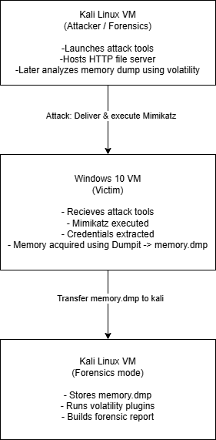
High-Level Project Architecture & Workflow
Two-VM isolated lab (Kali attacker + Windows victim)
Host-Only network prevents external exposure
Workflow: Setup → Attack → Memory Acquisition → Forensics → Comparison
Each memory dump analyzed chronologically to reconstruct the attack

Slide 3
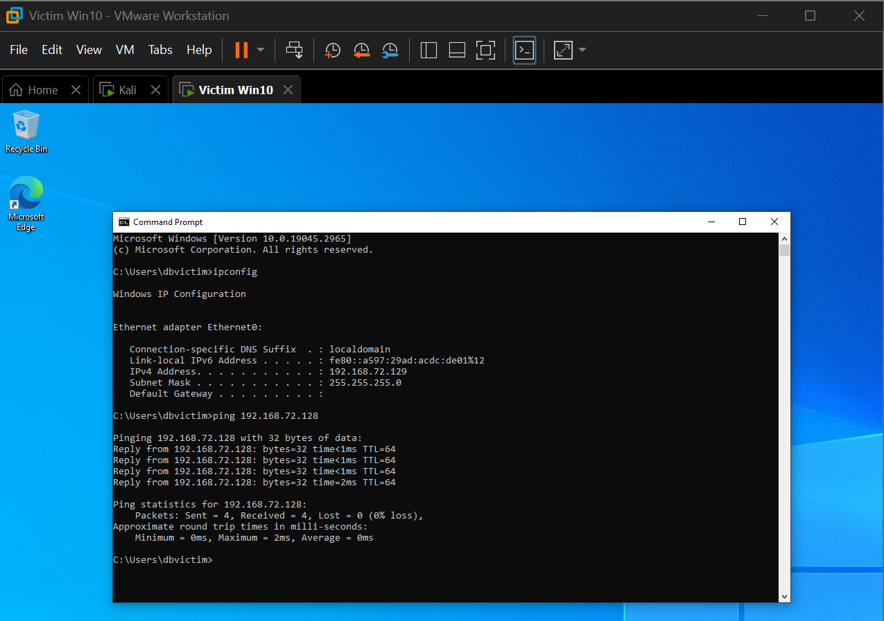
Verifying Host-Only Network Communication
Validates attacker ↔ victim communication
Required for tool delivery (DumpIt, Mimikatz)
Ensures full isolation from real networks

Slide 4
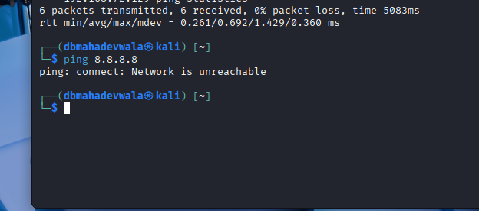
Ensuring a Controlled Forensic Environment
No internet connectivity on either VM
Prevents accidental external traffic
Confirms lab is fully contained

Slide 5
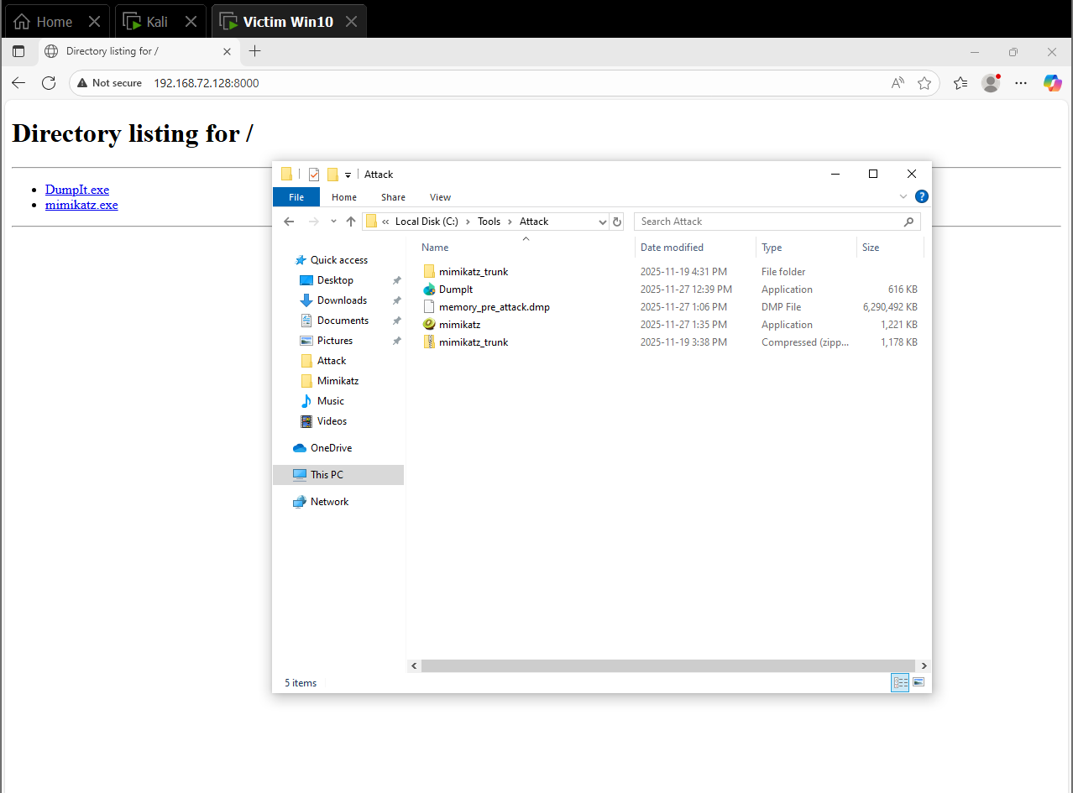
Attack Tool Delivery via HTTP Server
Kali hosts a Python HTTP server
Victim downloads DumpIt & Mimikatz from attacker
Demonstrates the initial attack staging phase

Slide 6
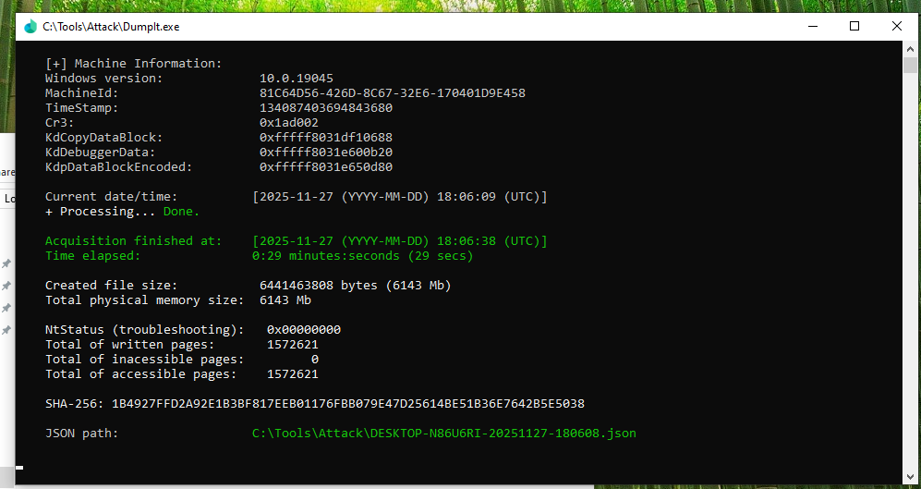
Capturing a Clean Baseline Memory Image
DumpIt executed before any malicious activity
Provides a “known good” memory state
Crucial reference for later forensic comparison

Slide 7
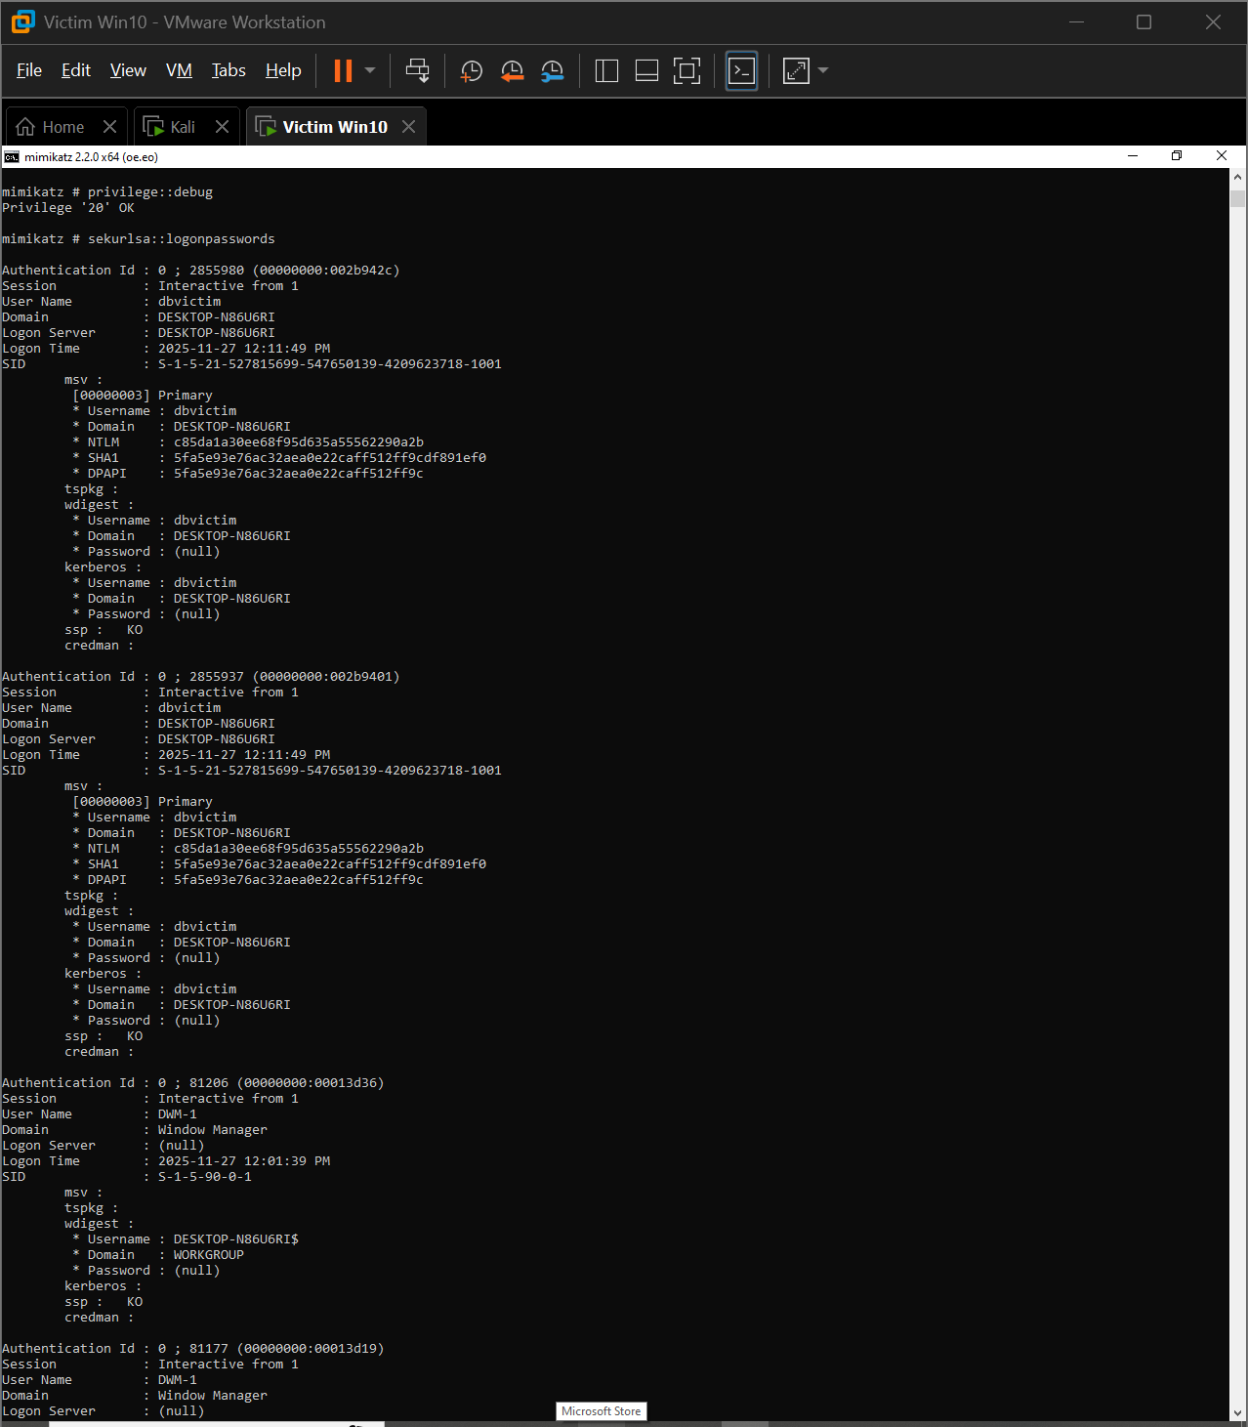
Credentials Targeted via Mimikatz
Executed interactively via cmd.exe
Attempted LSASS credential extraction
Even without plaintext, LSASS access artifacts persist in memory

Slide 8
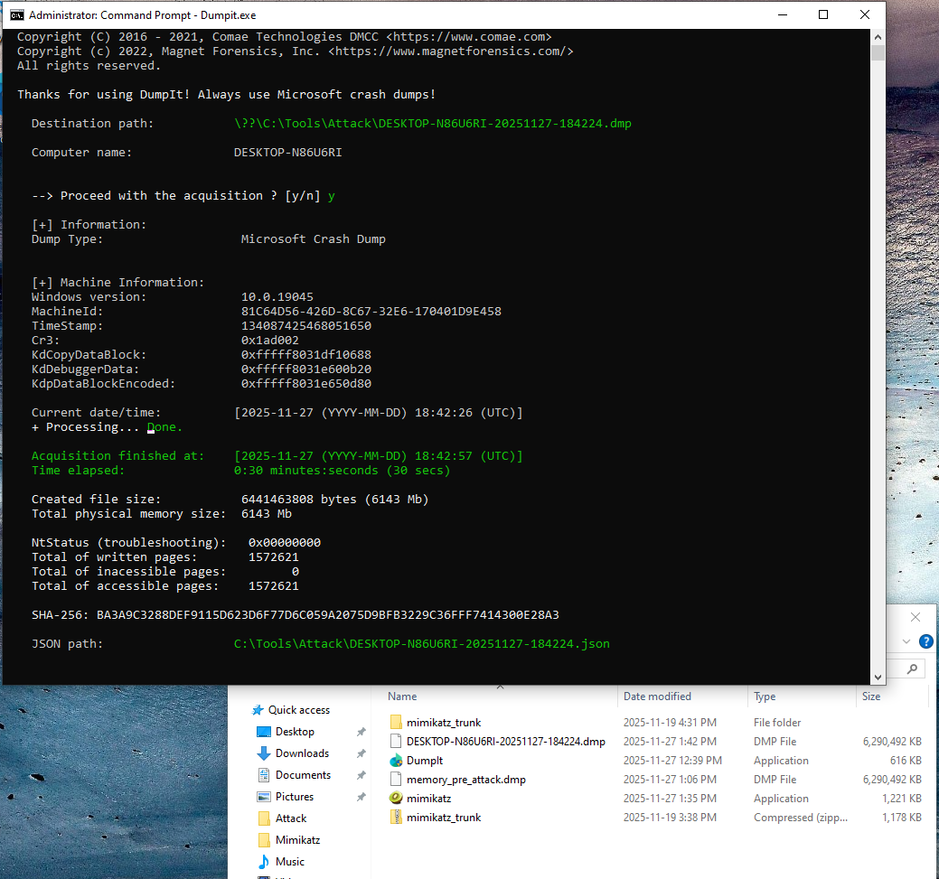
Capturing Memory During Active Compromise
DumpIt executed while Mimikatz + console chain running
Stores volatile attacker behavior (LSASS handles, process hierarchy)
Most forensically rich memory capture

Slide 9
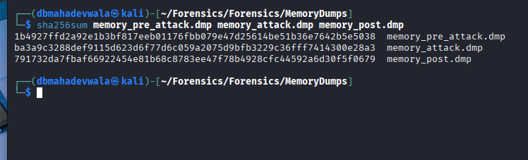
Unique Hashes Confirm Distinct Memory States
SHA-256 used to validate image integrity
Confirms dumps are unique (no accidental duplicates)
Required for forensic chain-of-custody

Slide 10
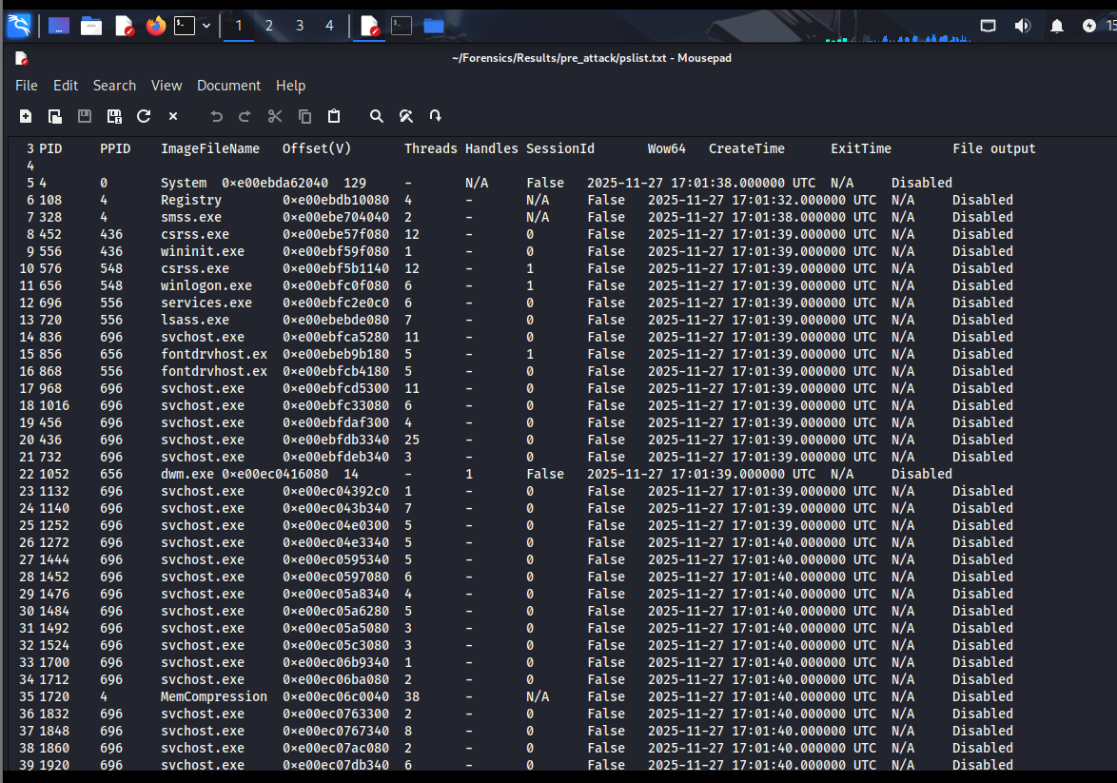
Clean System State Reconstruction
pslist shows only legitimate Windows processes
pstree reveals normal explorer.exe hierarchy
No interaction with LSASS or attacker tools
Establishes the system’s untouched condition

Slide 11
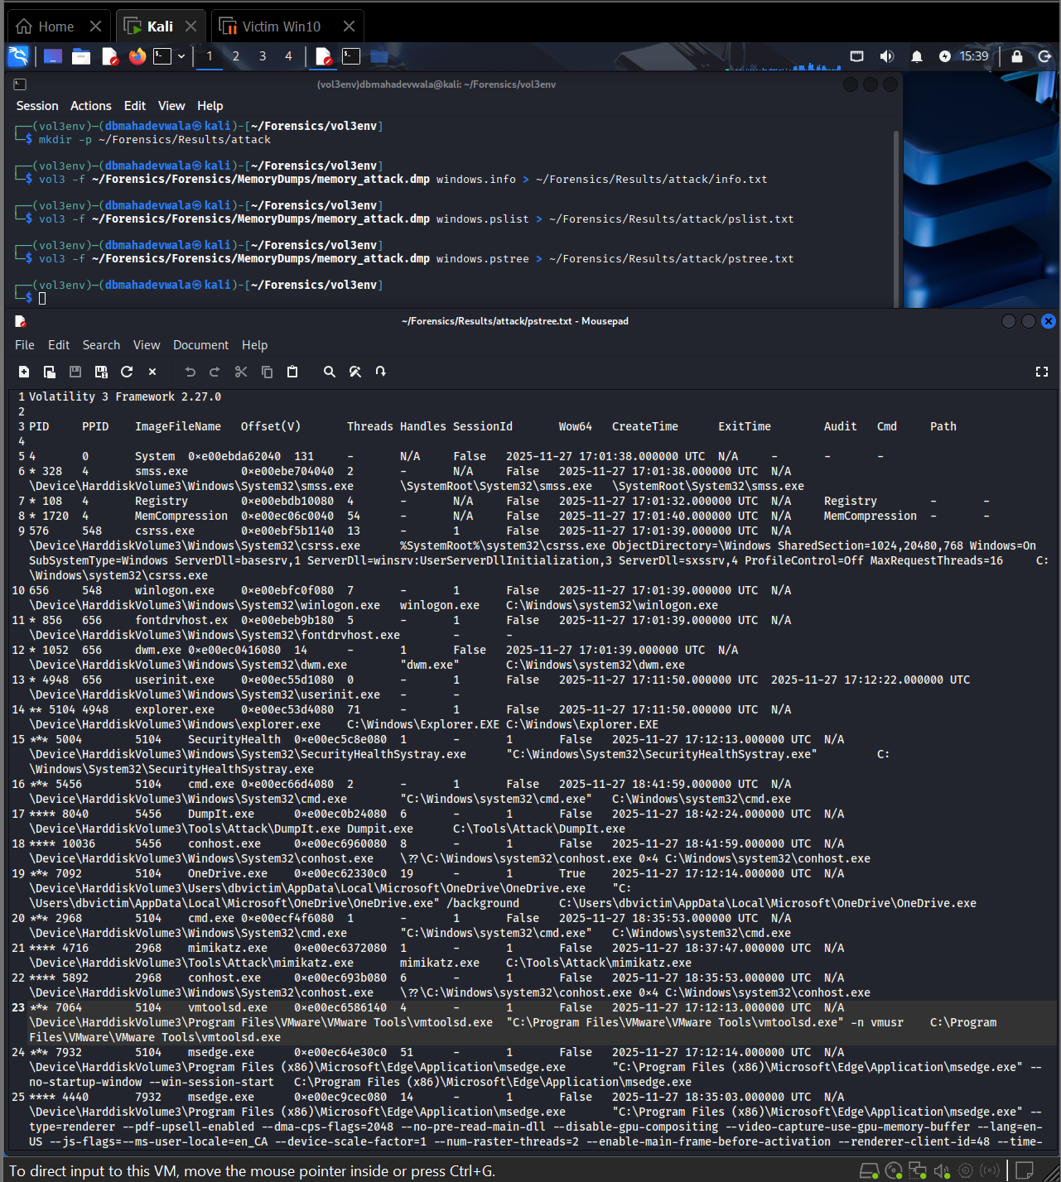
Process Tree Linking Attacker Activity
explorer.exe → cmd.exe → conhost.exe → mimikatz.exe / DumpIt.exe
Shows interactive hands-on-keyboard activity
Confirms malicious binaries initiated by user session

Slide 12
Mimikatz Access to LSASS Confirmed
handles output shows mimikatz.exe opening LSASS with PROCESS_ALL_ACCESS
Strongest forensic indicator of credential theft
LSASS interaction persists even when plaintext passwords don’t appear

Slide 13
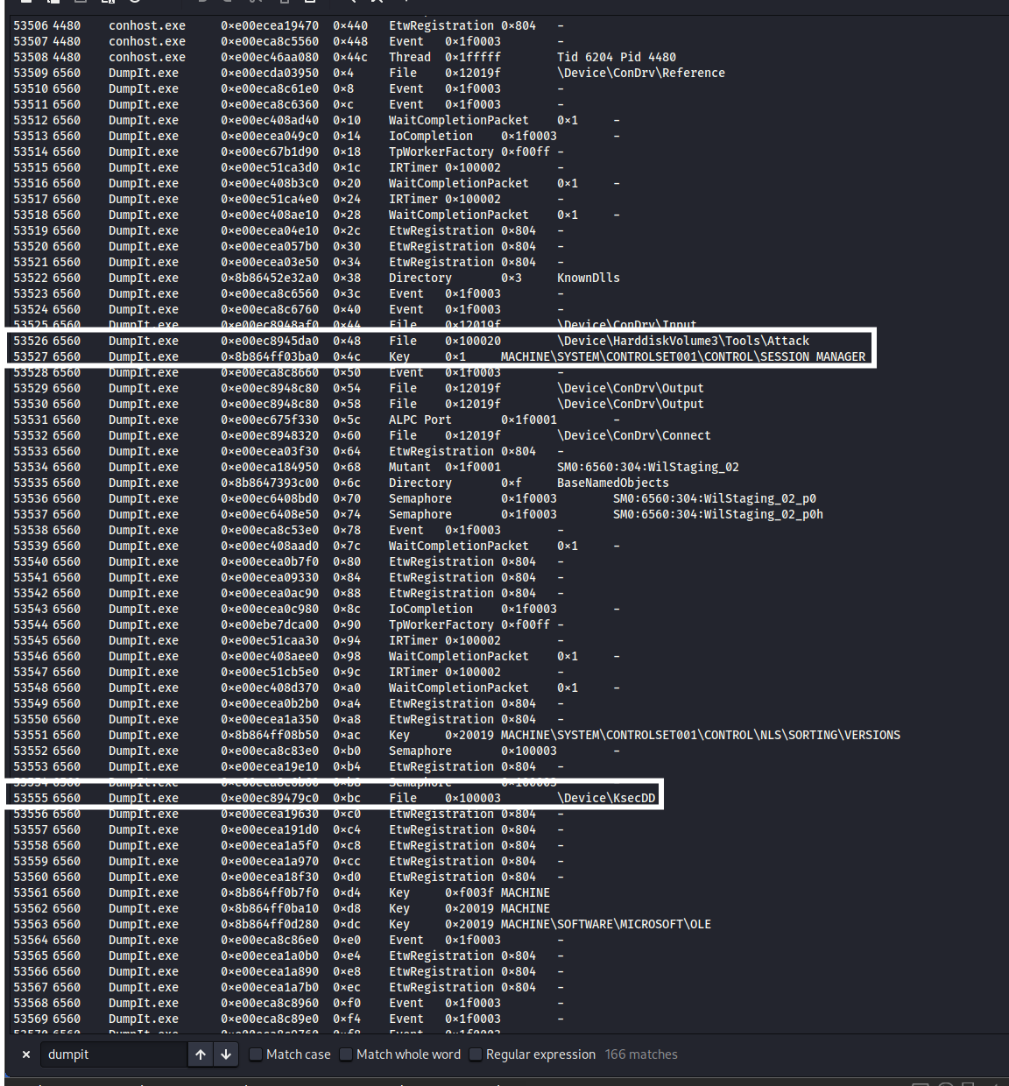
Proof of Full System Memory Extraction
DumpIt.exe opens \Device\KsecDD (kernel cryptographic driver)
Indicates privileged low-level memory access
Confirms attacker performed full RAM dump

Slide 14
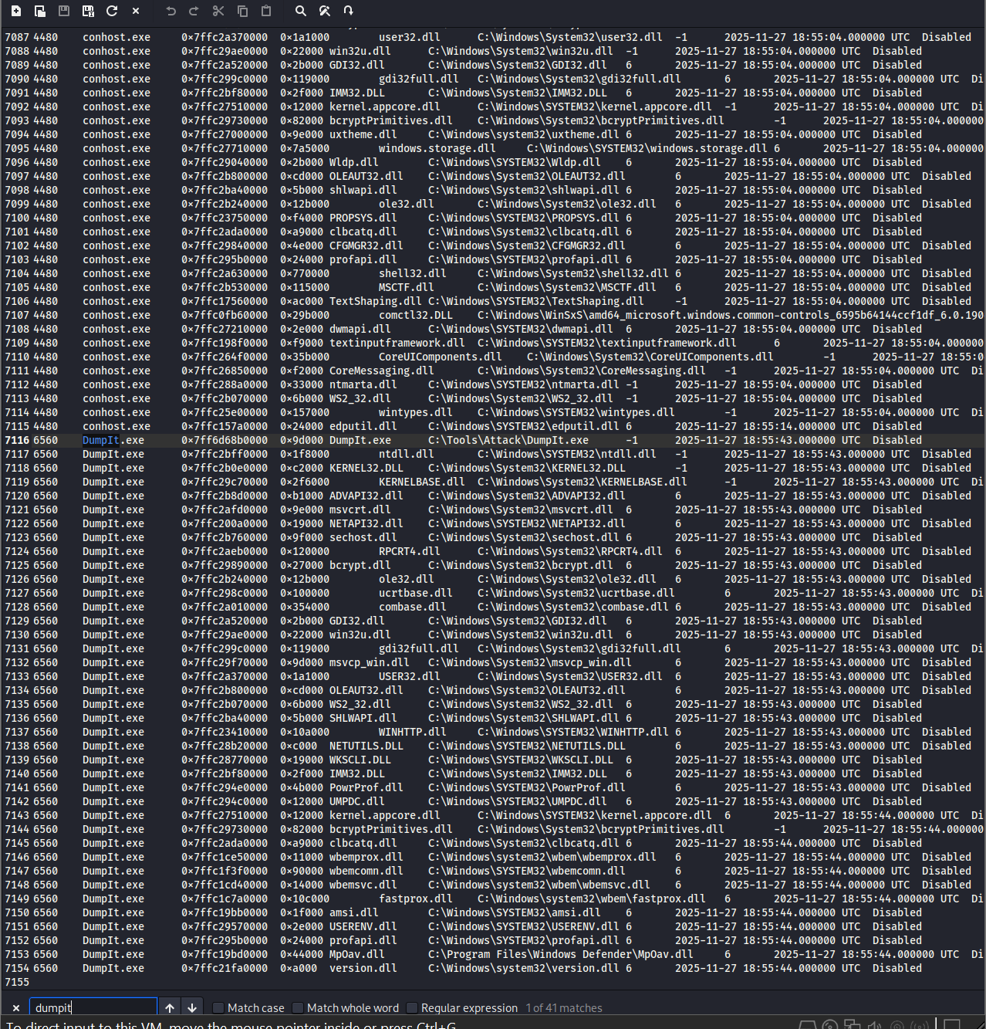
DLL Loading Confirms Attacker Console Session
conhost.exe loads modules used in attacker activity
Shares DLL footprint with DumpIt & Mimikatz
Proves GUI → cmd → console chain used for execution

Slide 15
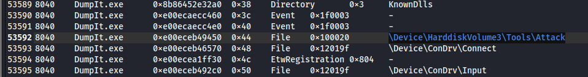


Phase 3 — Multi-Artifact Correlation During the Attack
pslist + pstree confirm malicious execution path:
explorer.exe → cmd.exe → conhost.exe → mimikatz.exe / DumpIt.exe
handles output links mimikatz.exe directly to LSASS credential structures
DumpIt kernel handles prove attacker obtained raw memory
dlllist confirms attacker binaries were loaded in the same console session
Correlating these artifacts transforms raw data into a complete attack narrative

Slide 16
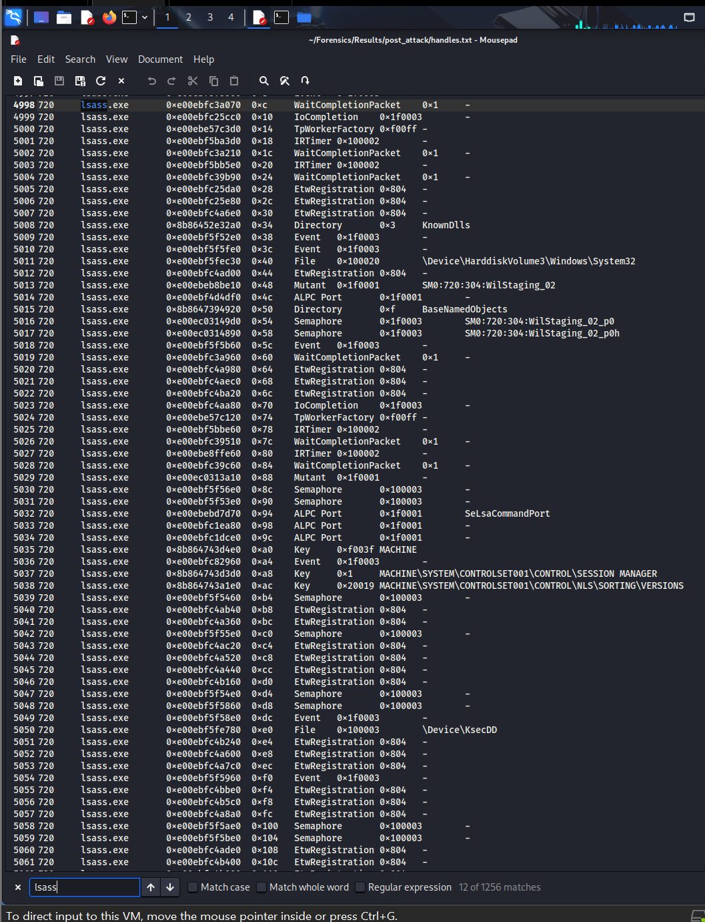
Evidence That Persists After Attacker Cleanup
mimikatz.exe no longer running, but explorer still references its folder
DumpIt continues to hold privileged kernel handles
Residual artifacts prove malicious activity even after tool termination

Slide 17
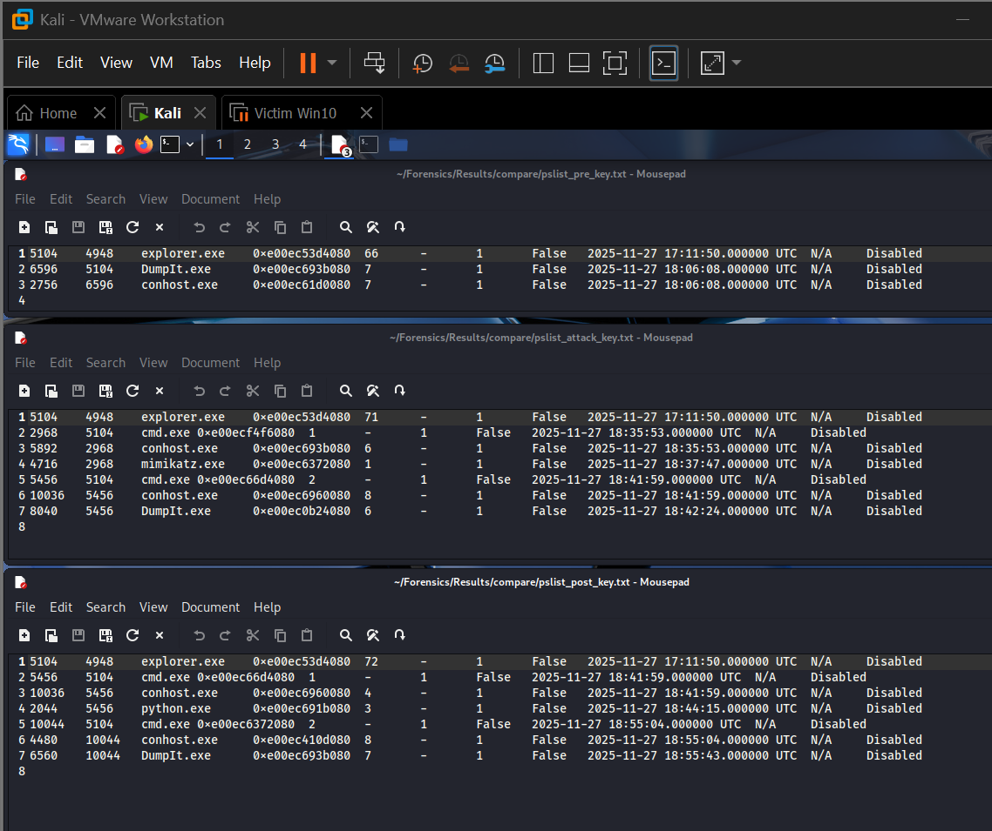
Pre-Attack vs During-Attack vs Post-Attack Comparison
Process | Pre-attack dump | During-attack dump | Post-attack dump
explorer.exe | Present, parent userinit, no link to attack tools | Present; parent of cmd.exe that launches tools | Present; still holds handles to Mimikatz directory
cmd.exe | Not present or only short-lived baseline activity | Present as child of explorer.exe; parent of conhost.exe and attacker tools | May still be present with conhost.exe and DumpIt chain
conhost.exe | Only generic console hosts (if any) | Specific instance associated with cmd.exe, child for DumpIt.exe / mimikatz.exe | Associated with cmd.exe / DumpIt.exe, but no active mimikatz.exe child
DumpIt.exe | Absent | Present; child of cmd.exe; holds KsecDD and disk handles | Present or recently exited; still has kernel-level and tool directory handles
mimikatz.exe | Absent | Present; child of cmd.exe / conhost.exe; opens LSASS handles | No longer listed as a running process, but handles and explorer references remain
lsass.exe | Present with normal handles and DLLs | Present; targeted by mimikatz.exe handles and possibly by DumpIt via full memory access | Present; shows no crash but continues normal activity after being accessed

Slide 18
Lessons Learned
Multi-stage memory capture reveals full attack lifecycle
Handles + DLLs often expose more than process lists
LSASS access always leaves forensic evidence
Memory forensics essential when attackers clean up tools
Volatility 3 required for modern Windows OS structures

Slide 19
Challenges Faced & How They Were Resolved
Volatility 2 incompatibility → migrated to Vol3
Kali disk-space failures → VM expansion + snapshot cleanup
Failed memory transfers → fixed via sha256 validation
Mimikatz plaintext inconsistencies → relied on LSASS handle forensics
Network instability → strict Host-Only configuration restored

Slide 20
Conclusion
Successfully reconstructed full credential-theft attack
Identified attacker execution path and LSASS compromise
Three-dump comparison produced complete incident narrative
Demonstrates advanced DFIR capability suitable for portfolio / resume
End-to-end lab fully replicates real-world IR workflow

